Slide 1
Screen Time & Mental Health: An Exploratory Data Analysis
Understanding behavioral patterns FOR THE ADULTS AND CHILREN through survey-based insights
By : Diwakar Kaushik

Slide 2
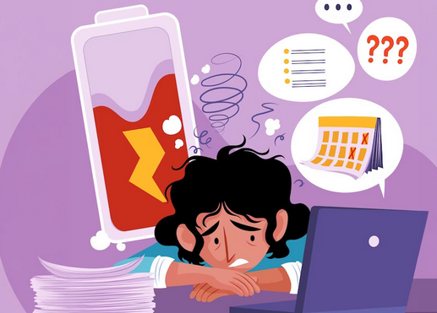
Problem Statement & Objective
Problem: With growing screen time, especially due to social media, concerns about its impact on mental health have increased.
Objective: To analyze patterns in social media use, emotional responses, and behavioral habits to understand how screen time might relate to distraction, mood fluctuations, and sleep issues.
Insight-Driven Exploration: Rather than building predictive models, the focus was on uncovering meaningful patterns, visual trends, and behavioral insights that can help raise awareness about digital well-being.

Slide 3
Solution & Data Sources
To explore the connection between screen time and mental well-being, conducted a deep exploratory data analysis (EDA) using real-world data.
Sourced three relevant datasets from Kaggle, all published within the last 1 to 3 years, ensuring the data reflects recent behavioral trends.
The datasets include:
>Digital Behavior – tracking screen time patterns and device usage.
>Social Media Behavior – focusing on emotions, comparison, and online habits.
> Phone Addiction – capturing signs of overuse, distraction, and dependency.
This multi-angle data approach helps us form a well-rounded analysis of how technology usage affects users mentally and emotionally.

Slide 4
MORE ABOUT DATA SETS
1. Digital Behavior Dataset
->This dataset captures insights into screen usage patterns, including time spent on devices, app categories used, and time-of-day preferences.
->It helps us understand daily digital habits and how they might relate to routine, focus, and productivity.
2. Social Media Behavior Dataset
->Focuses on emotional and psychological aspects of social media use.
->Includes questions on comparison with others, validation seeking, and distraction levels—making it ideal for assessing the mental health impact of social platforms.
3. Mobile Addiction Dataset
->Designed to evaluate signs of phone dependency, such as compulsive checking, anxiety when not using the phone, and difficulty staying offline.
->Offers strong signals for identifying addictive tendencies and their link to stress, mood swings, or sleep issues.

Slide 5
Tools & Technologies Used
Google Collab :- Utilized as the main platform for writing and executing code, ensuring a smooth and collaborative workflow.
Python (Pandas, NumPy, Seaborn, Matplotlib) :- Used for data loading, cleaning, manipulation, and visualization. These libraries helped explore trends, draw comparisons, and generate meaningful visual insights.
Data Cleaning & Preprocessing Techniques :- Handled missing values, standardized categories, and transformed string-based time data into numerical formats for easier analysis.
Visualization Tools :- Bar plots, boxplots, hisplots and heatmaps were used to uncover relationships between digital behavior and mental well-being.

Slide 6
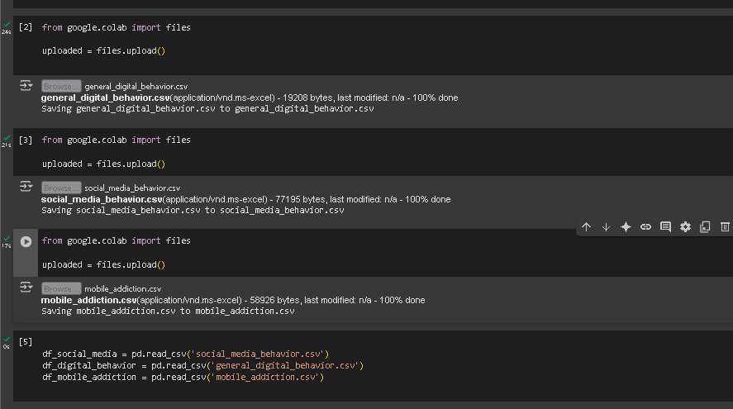
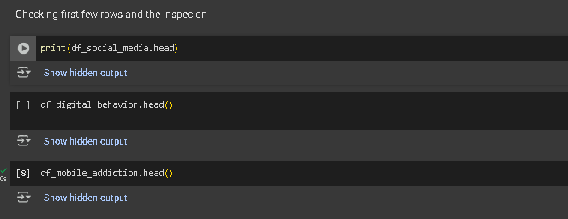
STEPS AND PROCEDURE
STEP-1 DATA LOADING AND OVERVIEW
All three datasets were loaded and previewed using .head().
Basic structure, checked if the data is loaded successfully or not .
AND IT IS WORKING FINE

Slide 7
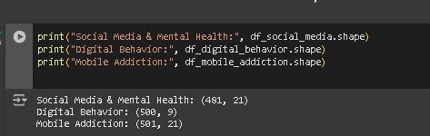
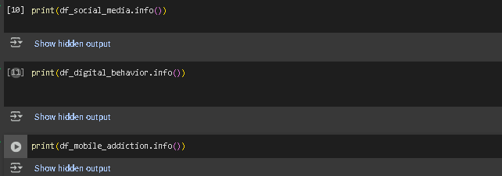
STEP 2 - GETTING THE INFO ,SHAPE and COLMNS
Checked the shape of each dataset to know how many rows and columns are present.
Listed all column names to get an overview of available features for analysis and checked the null values and fixed them

Slide 8
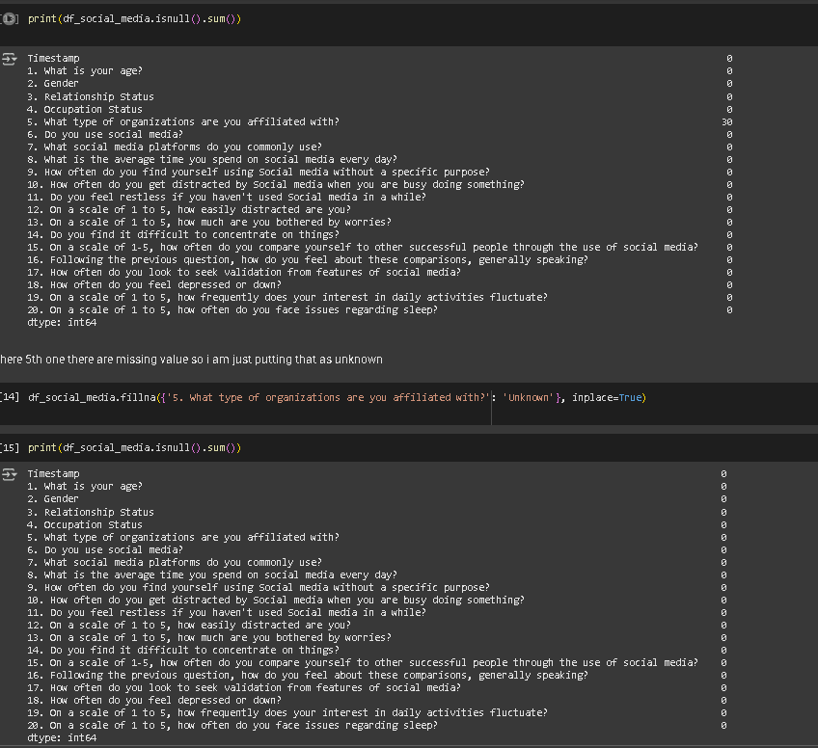
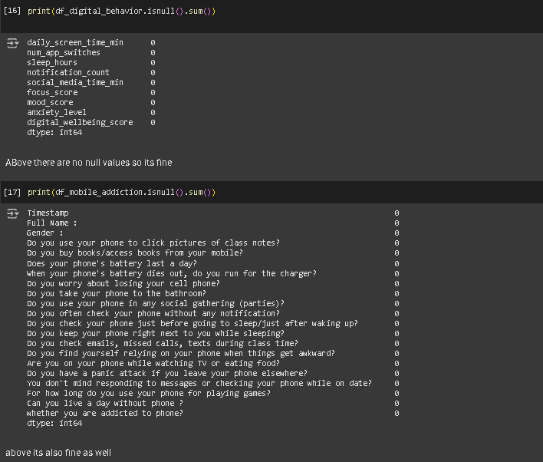
For the null values

Slide 9
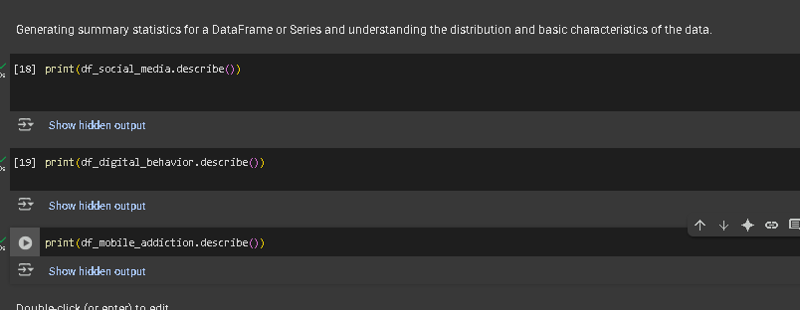
Initial Data Insights
→ Most participants are in their early 20s. A significant portion frequently uses social media without specific intent and reports moderate distraction. Emotional responses such as worry, low mood, and sleep disturbances are commonly seen, though restlessness without access to social media remains low
→Digital behavior data reveals an average screen time of ~6 hours/day with high notification counts. Despite generally good mood and focus levels, anxiety remains high, and some users report significantly low sleep durations — indicating mixed digital wellbeing outcomes.
→Mobile usage behaviors indicate high dependence, with a majority of users engaging with their phones during personal, social, and even awkward situations. Despite this, many deny being addicted, suggesting a behavioral-perception gap

Slide 10
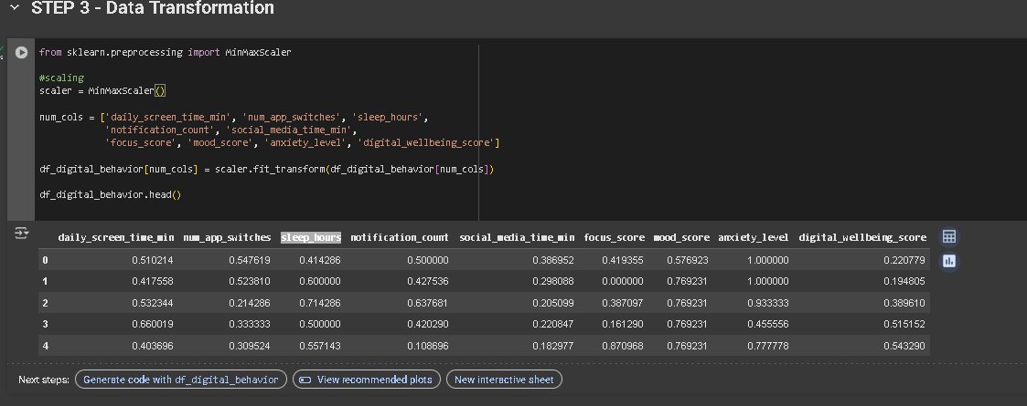
Step 3 – Data Transformation
These were scaled between 0 and 1 using Min-Max Normalization to preserve relative differences and make visualizations meaningful.

Slide 11
There I have only done for the digital behavior dataset . But Why ?
Social Media Dataset
Already in human-readable formats (e.g., Likert scale values from 1–5).
No irregular scales or units to normalize.
Mobile Addiction Dataset
Mostly categorical or binary variables (like Yes/No, Male/Female, Do you check phone before bed?)
Already suitable for direct analysis and visual interpretation.
SO in conclusion I can say Only the Digital Behavior dataset required transformation, as it contained measurable quantities with varying scales. This step ensured consistency and better comparability across features

Slide 12
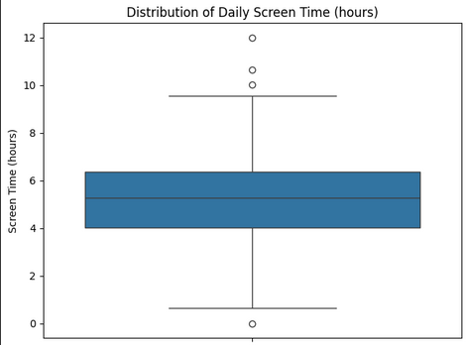
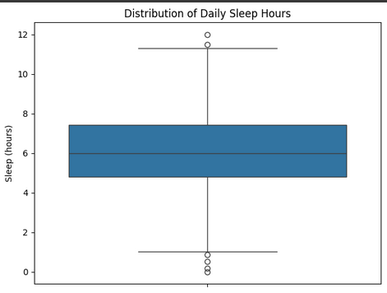
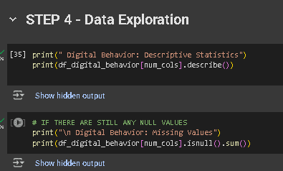
STEP 4 - Data Exploration
In this step, explored the structure and content of each dataset to understand distributions, spot anomalies, and identify meaningful patterns.
FOR THE DIGITAL BEHAVIOUR SET
ALSO DID BOX PLOTS TO FOR SEEING THE OUTLIERS AND THE TREND

Slide 13
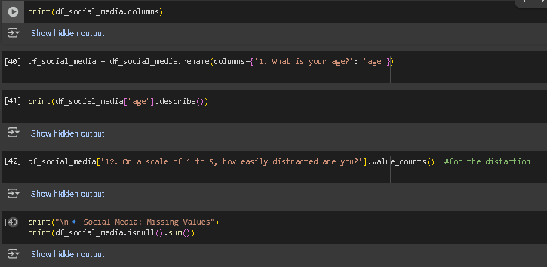
For Social Media

Slide 14
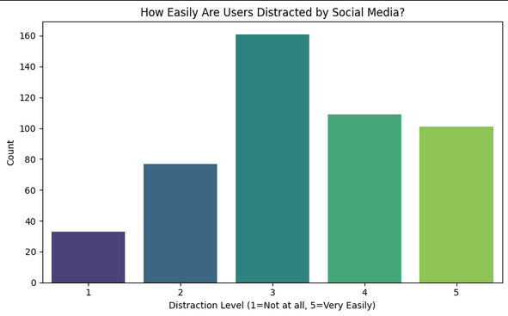
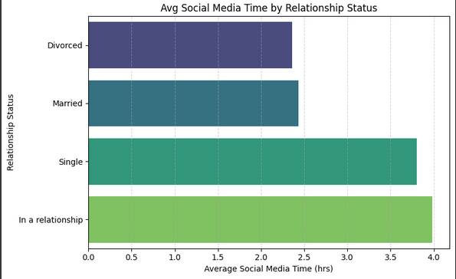
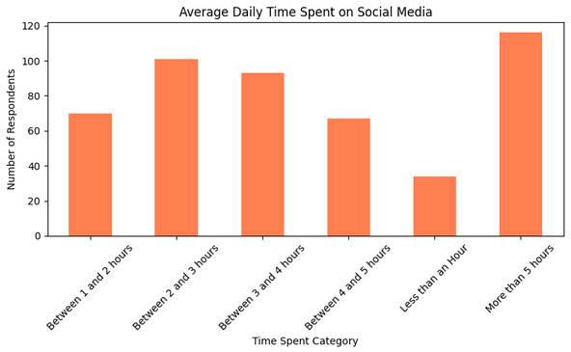
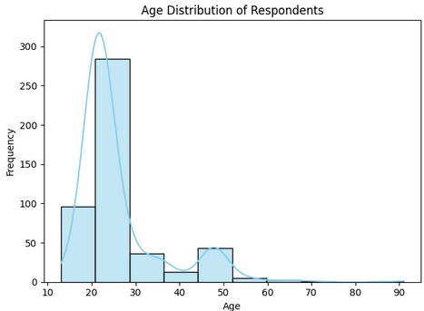
Now For the plotting I have done and analyzed

Slide 15
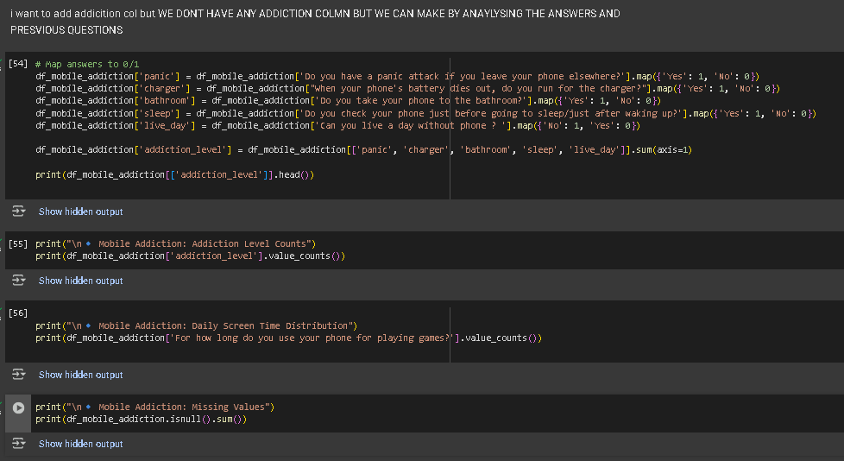
Lastly for the mobile addiction :-
Binary Mapping of Key Behaviors
To quantify addiction behaviors, mapped the following questions to binary (1/0) values:
Then created a new column addiction level by summing up the binary values.
This score ranges from 0 to 5, where higher scores indicate higher levels of self-reported mobile dependency.

Slide 16
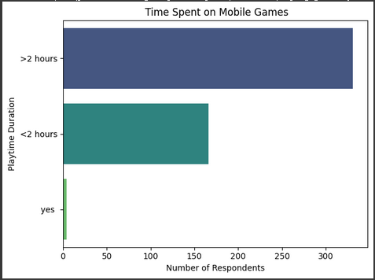
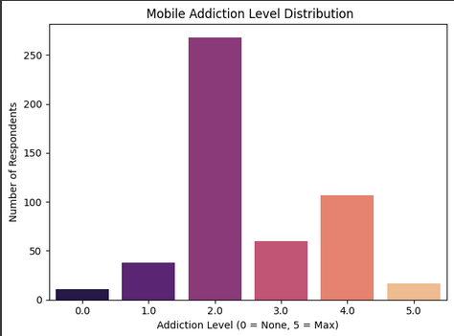
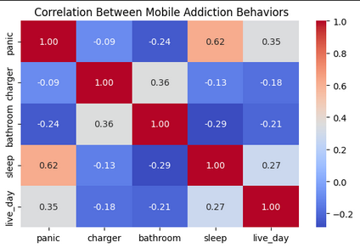
For the insights and the plots

Slide 17
NOW STEP 5 - DATA FILTERRING
In this stage, focused on identifying users with high engagement or problematic patterns related datasets by applying custom logic and thresholds.
FOR THE SOCIAL MEDIA ONE
CLEANING TIME DATA :-
I first standardized the responses to the question: “What is the average time you spend on social media every day?”
Then handled entries by converting them into numeric values
Based on that created new col named social time hr for the analysis.

Slide 18
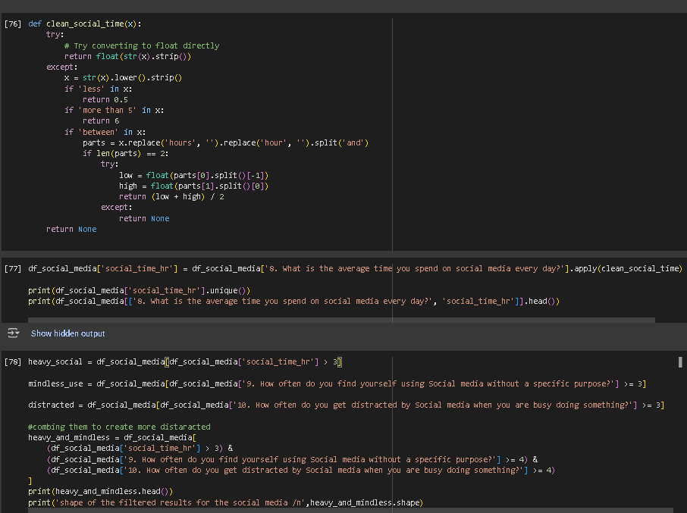

Slide 19
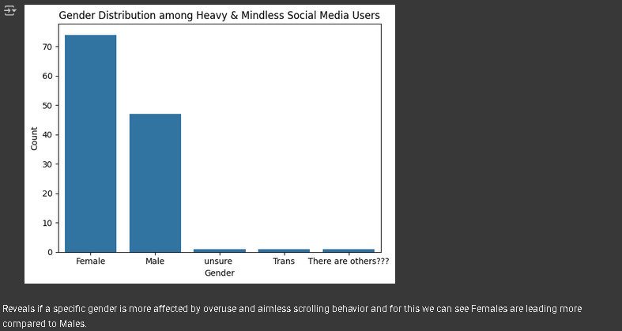
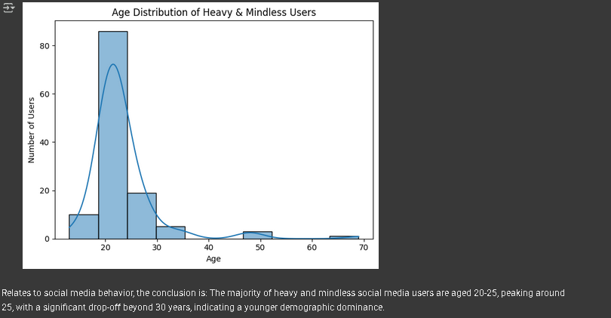
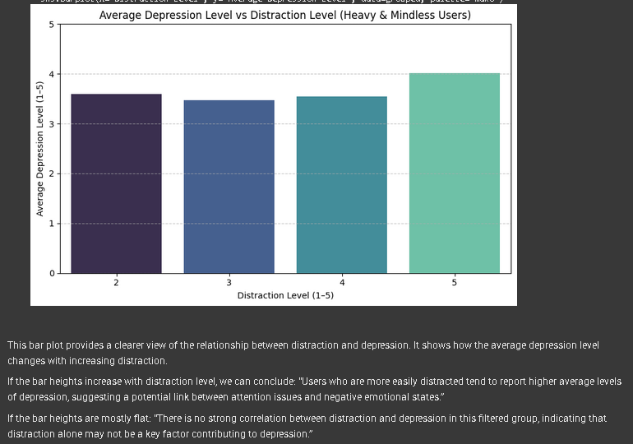
Analysis and the plots based on that

Slide 20
For the digital behavior
After transforming the data into actual measurable units (e.g., screen time in hours, sleep in hours, app switches as integers), I applied a filtering process to identify users who show potentially concerning digital habits.
Now the Logic is I defined a set of conditions to detect users who might be at risk of digital fatigue or poor well-being:
Heavy Screen Time: Spending more than 5 hours daily in front of a screen.
Frequent App Switching: Performing over 100 app switches a day, suggesting frequent task changes or distraction.
Poor Sleep Patterns: Getting less than 6 hours of sleep, which may be insufficient for mental and physical recovery. Then putting them in at_risk which is also new that is created and contains –ve effects of digital overuse

Slide 21
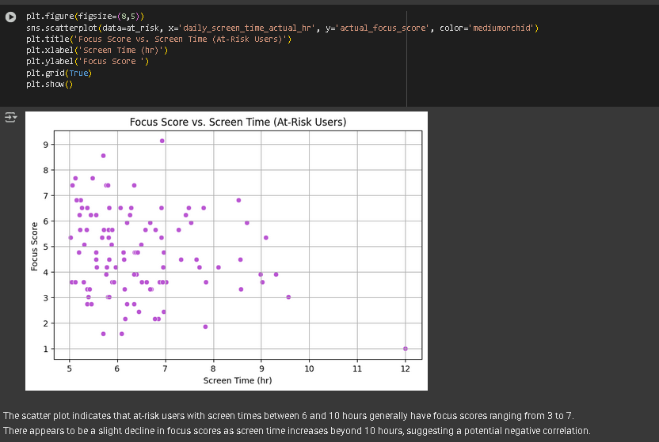
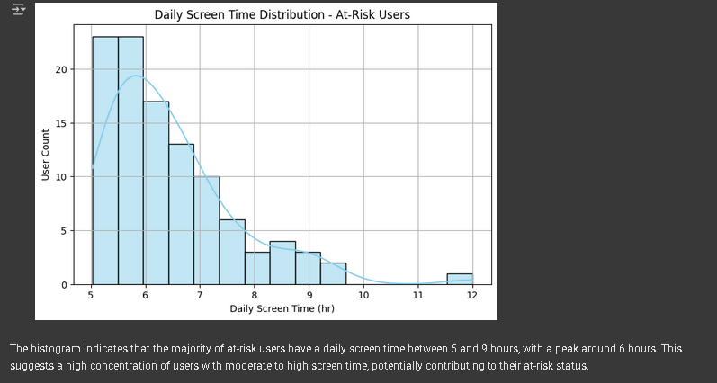
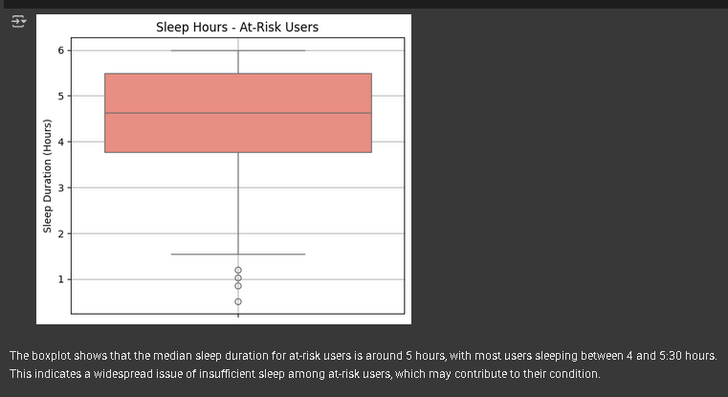
Plotting some of the values

Slide 22
Lasty Mobile Addiction
To identify users who show signs of problematic mobile phone usage, we focused on five key behavioral indicators from the survey:
Checking phone before sleep or right after waking up
Sleeping with the phone nearby
Worrying about losing the phone
Panic when phone is left behind
Inability to go a day without using the phone
Each response was recoded:
YES IS 1 NO IS 0
An Addiction Score was then calculated by summing these binary indicators. Users with a score of 3 or more were flagged as "likely addicted."

Slide 23
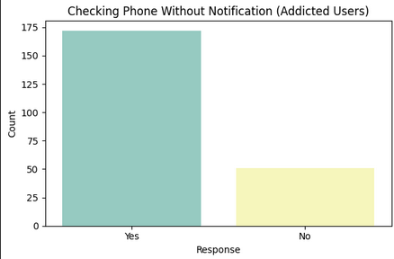
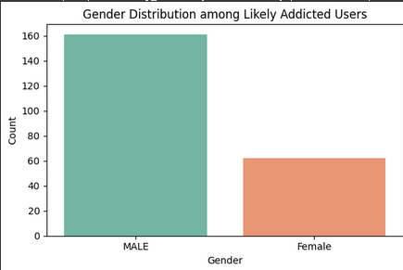
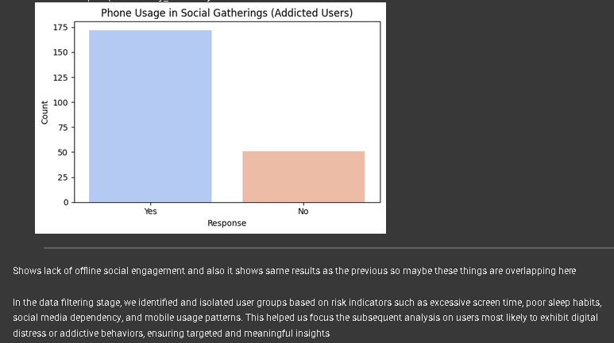

Slide 24
STEP 6 FINAL DATA VISUALIZATION ANALYSIS
To gain a holistic understanding of digital well-being, we combined key features from all three datasets:
SO FIRSTLY, WE ARE TAKING
Sleep Duration from the Digital Behavior dataset
Distraction Level from the Social Media dataset
Addiction Score from the Mobile Addiction dataset
This merged dataset Allowed us to explore how these variables interact together. For instance:
By combining these insights, we aimed to answer questions like:
Do individuals with higher mobile addiction scores also report lower sleep durations?
is higher social media-related distraction linked to worse digital behavior patterns?
All rows with missing data were dropped to ensure clean, consistent analysis.
This step helped connect the dots across dimensions , highlighting deeper behavioral trends that may not be visible when analyzing each dataset in isolation.

Slide 25
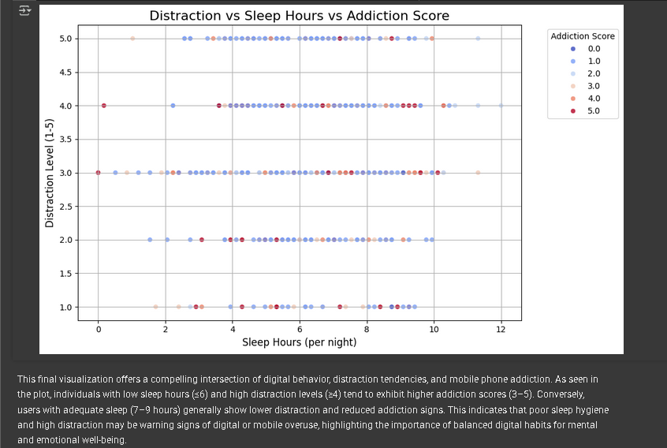

Slide 26
Now for Combined Analysis: Screen Time, Social Comparison & Addiction
To dig deeper into psychological patterns of digital usage, the analysis now brings together:
Daily Screen Time from the Digital Behavior dataset
Social Comparison Tendencies from the Social Media dataset
Phone Addiction Score from the Mobile Addiction dataset
Individuals who frequently compare themselves to others on social media And also show signs of phone addiction Might engage in excessive screen time
This approach was motivated by the hypothesis that self-comparison and addiction may mutually reinforce increased device usage.

Slide 27
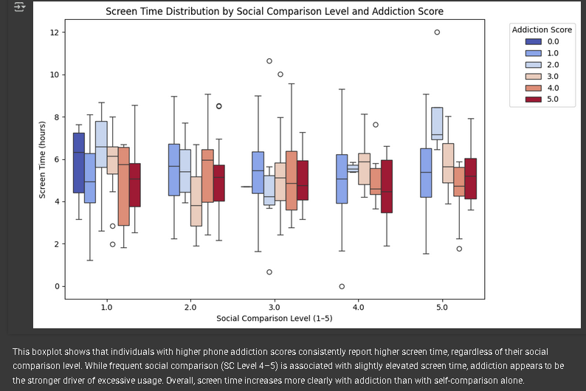

Slide 28
Lastly with merging screen time, mood score, and anxiety level to analyze the mental well-being aspect of digital behavior.
Analyzing Mental Well-being: Screen Time, Mood & Anxiety
In this step, the focus shifts to the mental health dimension of digital usage by combining:
Daily Screen Time (from Digital Behavior data)
Mood Score (self-reported feeling levels)
Anxiety Level (self-reported psychological state)
The idea behind this merge is to examine whether:
Users with higher screen time tend to report lower mood scores, and
Whether there's a link between anxiety levels and digital overuse.

Slide 29
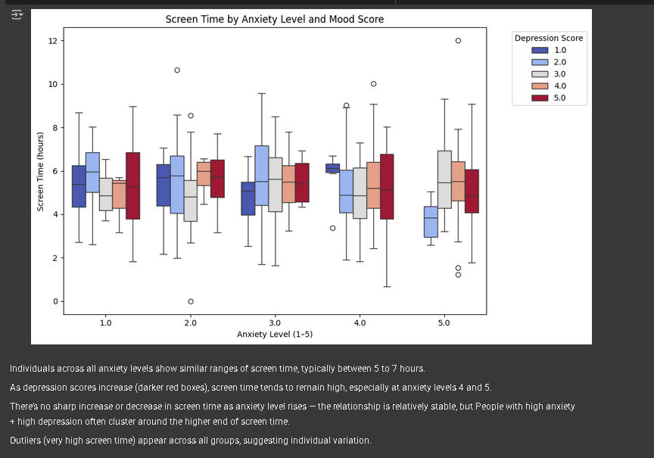

Slide 30
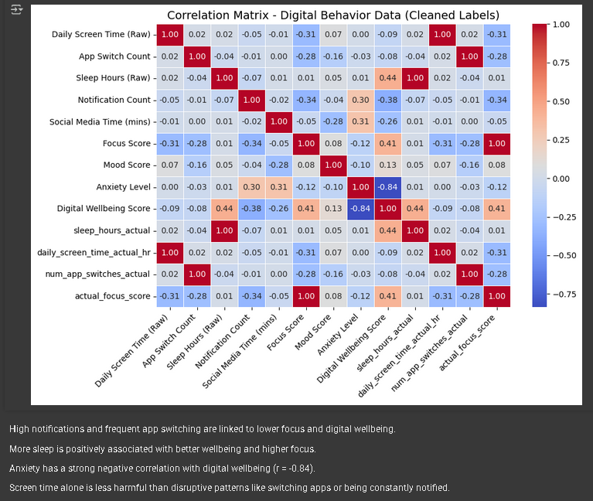
STEP 7 - CORREALTION ANALYSIS
For the Digital Behavior Data

Slide 31
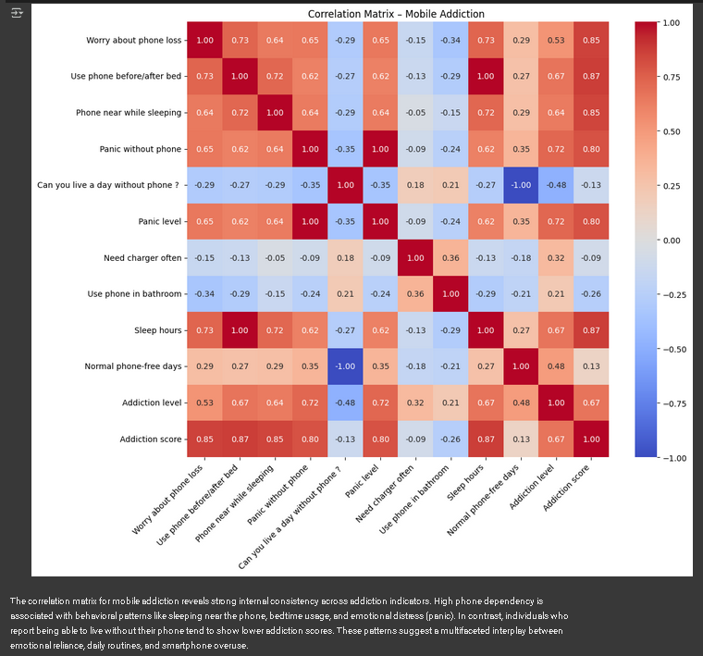
For Mobile Addiction

Slide 32
Tried to perform a correlation analysis for the social media dataset, but most of the columns are text-based (categorical) and not numeric. Because of this, we couldn't create a meaningful correlation matrix. To do this in the future, we would first need to convert the data into numeric form using techniques like encoding but doing that only for the numeric ones
Lasty For the Social Media

Slide 33
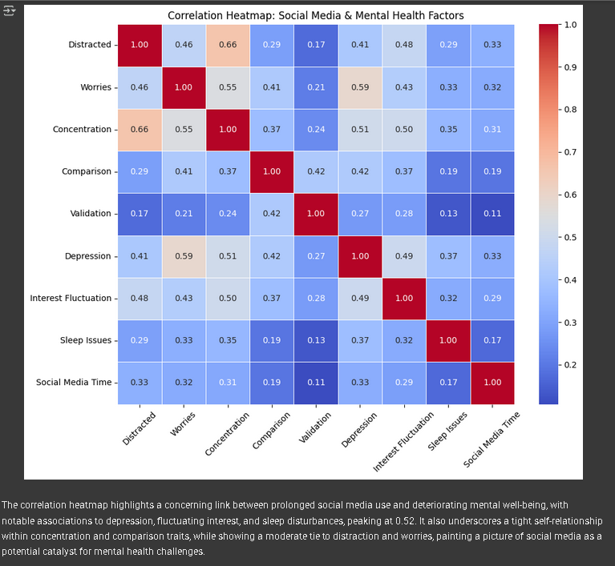

Slide 34
CONCLUSION AND RESULTS
Mobile Addiction Dataset: Key Insights
Usage Across Genders: Both males and females showed high mobile usage, with minor variation in addiction scores.
Perception vs Reality: Many users who claimed they weren’t addicted still had high addiction scores, revealing a gap between self-perception and actual behavior.
Correlations: Screen time showed a strong positive correlation with addiction scores, confirming it as a major contributor.
CONCLUSION :-
Mobile addiction is often underestimated by users. This highlights the need for better awareness and self-monitoring to recognize unhealthy usage patterns.

Slide 35
Social Media Dataset: Key Insights
Gender Trends: Both genders are active on social media, but females showed slightly higher usage, possibly due to lifestyle or communication preferences.
Relationship Status Impact: Users in relationships tended to spend more time on social media, hinting at different priorities or social needs.
Correlation Limitation: Most variables were categorical, so we relied on visual trends rather than numerical correlations.
Conclusion ;- Social media behavior is shaped by personal lifestyle factors. Even without correlations, plots revealed meaningful usage patterns.

Slide 36
Digital Behavior Dataset: Key Insights
Realistic Data Conversion: Normalized values were converted into actual hours and minutes, allowing for more intuitive visual analysis.
Screen Time vs Sleep: A clear negative trend showed that as screen time increased, sleep duration decreased, supporting known concerns about digital overuse and rest quality.
Usage Distribution: Most users logged 5 to 7.5 hours of screen time daily, reflecting heavy daily engagement with digital devices.
Conclusion :-
Prolonged digital usage is linked to reduced sleep and may impact well-being. Limiting screen time could support healthier habits.

Slide 37
RESULTS
Overall Conclusions ;-
High Digital Usage was observed across all datasets — particularly in screen time and mobile phone habits.
Clear links emerged between digital behavior and lifestyle factors like sleep duration, relationship status, and self-awareness of addiction.
Key Patterns Identified through visual analysis:
More Screen Time → Less Sleep
Higher Addiction Scores → Increased Usage
Singles & Couples → More Social Media Activity

Slide 38
Recommendations
Awareness Campaigns: Many users underestimate their digital dependence. Programs comparing self-perception vs actual data can raise awareness.
Digital Wellness Tools: Apps that track usage, encourage breaks, and suggest limits can help users manage screen time and improve well-being.
Future Research: Including time-series data and broader demographics could uncover deeper behavioral trends and support more targeted interventions.

Slide 39
THANK YOU FOR YOUR TIME

